Slide 1

Telephone Customer Churn Analysis
Jamaal Smith
Flatiron School

Slide 2
Executive Summary
Identifying customers at-risk of changing services vital to business success. More funds expended attracting new customers than retaining old customers.
Development of classification model will assist with business retention efforts.
The goal of this analysis is to highlight the handful of customer characteristics that best portend future customer behaviors.

Slide 3
Table of Contents
Executive Summary
Findings
Next Steps
Appendix

Slide 4
Initial Impressions of Data Set
Is the dataset robust or small?
What are the feature variables that are worth keeping for analysis versus those that are futile?
Are there any columns that we can dismiss at this moment?
% Churn | % Remain
14.5 | 85.5
Notes:
The dataset is comprised of 21 unique columns with 3333 rows of data. After first review, columns such as the phone number column can be deleted because a given phone number gives no insight into whether someone will leave their plan. By this, if someone had my phone number before, it isn’t logical to assume that my behaviors will be the same because I now have their phone number. This is why we can delete the phone column. Another feature variable that can be omitted is the state column. This is because there is no higher level of churn in one state that is attributable to the state alone that will allow us to make any useful insights.
As we can see, the churn phenomena is pretty scarce and most customers usually stay with the provider. Thus, identifying those feature variables that drive customers to eventually leave the company takes on even more significance

Slide 5
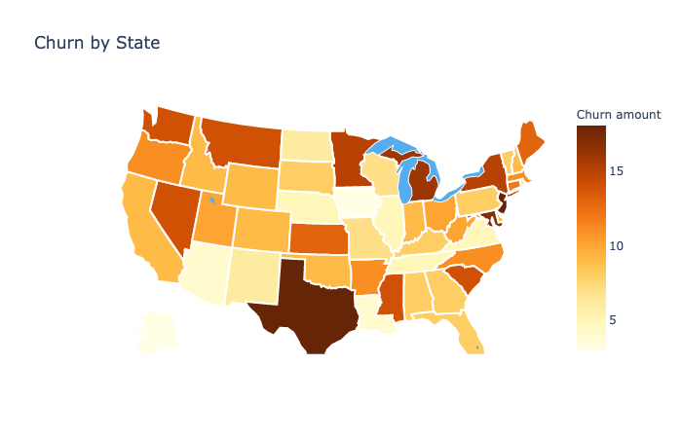
Churn By State – Is Churn A GeoGpraphical Phenomena As Well?
For states such as Texas, New Jersey and Michigan; could churn be caused by something specific to these localities?
Identifying exact cause of higher churn in these specific states can be valuable after-work opportunity.
Notes:
The dataset is comprised of 21 unique columns with 3333 rows of data. After first review, columns such as the phone number column can be deleted because a given phone number gives no insight into whether someone will leave their plan. By this, if someone had my phone number before, it isn’t logical to assume that my behaviors will be the same because I now have their phone number. This is why we can delete the phone column. Another feature variable that can be omitted is the state column. This is because there is no higher level of churn in one state that is attributable to the state alone that will allow us to make any useful insights.
As we can see, the churn phenomena is pretty scarce and most customers usually stay with the provider. Thus, identifying those feature variables that drive customers to eventually leave the company takes on even more significance

Slide 6
Feature Variables that Speak to Heightened account Length
Using account length as a proxy for churn, preliminary analysis of the data speaks to those that might more day and international calls having higher account lengths and those that make night calls having a slightly less account length

Slide 7
Correlation Between Features and Account length

Slide 8
Classifier Model: XGBOOST (All Variables)
Across three measures of feature importance, the number of customer service calls, possession of international plan and total day minutes are toward the top of the list of feature values of import.
Notes:
Weight. The number of times a feature is used to split the data across all trees.
Cover. The number of times a feature is used to split the data across all trees weighted by the number of training data points that go through those splits.
Gain. The average training loss reduction gained when using a feature for splitting.

Slide 9
XGBOOST Model Performance – All Variables Versus Feature Selection
Accuracy = 94.5% (all variables)
Accuracy = 90.0% (top 4)

Slide 10
Table of Contents
Executive Summary
Findings
Next Steps
Appendix

Slide 11
Thank You For Your Time – Follow-Up Work Proposals
It was a pleasure performing this analysis to assist with keeping your brand a leader in the marketplace.
As follow-up, we would be glad to:
Perform analysis on the top 4 feature variables to provide the leadership team with a decision tree that can establish important milestones that will enable your team to take proactive measures to prevent churn.
Feed new datapoints into the model so that your leadership team to ensure that the model is adaptable to new datapoints and simply doesn’t replicate the training data.
Examine the cause of higher churn in certain states. Is this a phenomena that is due to infrastructure in that locality or other market forces that we might have been unaware of during this analysis.

Slide 12
Table of Contents
Executive Summary
Findings
Next Steps
Appendix

Slide 13
Classifier Model: XGBOOST (Feature Selection)
Across three measures of feature importance, the number of customer service calls, possession of international plan and total day minutes are toward the top of the list of feature values of import.
Notes:
Weight. The number of times a feature is used to split the data across all trees.
Cover. The number of times a feature is used to split the data across all trees weighted by the number of training data points that go through those splits.
Gain. The average training loss reduction gained when using a feature for splitting.

Slide 14
XGBOOSt Model PeRformance (ALL Features)

Slide 15
XGBOOSt Model PeRformance (Top 4)

Slide 16
Visual analysis of Feature Variable Correlation with Account Length

Slide 17
Visual analysis of Feature Variable Correlation with Account Length (CONTD)

Slide 18
Visual analysis of Feature Variable Correlation with Account Length (CONTD)

Slide 19
Visual analysis of Feature Variable Correlation with Account Length (CONTD)

